Slide 1
Ship Recognition based on YOLOv8 Model for ASV
Nithin Narayanan R (Roll No:47521006)
Under the Guidance of
Dr. G. Santhosh Kumar, Professor
Department of Computer Science Cochin University of Science And Technology

Slide 2
Overview
Introduction
Motivation
Related Works
Related works summary
Research Gap
Objectives
Problem Statement
Proposed System
Conclusion
Reference

Slide 3
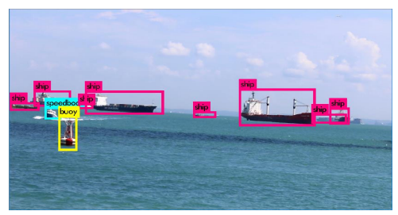
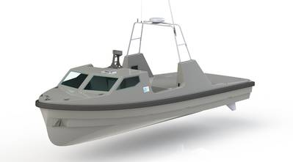
Introduction
Overview: Autonomous Surface Vessels (ASVs) are unmanned, self-propelled vessels designed to operate on the water's surface without human intervention.
Significance of Object Detection and Classification for ASVs:
Object detection ensures safer navigation for ASVs by identifying obstacles, other vessels, or potential hazards, minimizing collision risks.
Object detection enables ASVs to operate autonomously, making real-time decisions based on detected objects, reducing the need for constant human intervention.
Classification of objects assists in mapping the environment, enabling ASVs to navigate efficiently through water bodies, optimizing their routes.
Fig: 1. Sample ASV illustration
Fig: 2. Ship detection example
Thales UK

Slide 4
Motivation
Enhancing ASV Operations
Accurate object detection and classification optimize ASV operations, reducing downtime and enhancing overall efficiency.
Complexity in Ship Identification
Distinguishing between diverse ship classes, sizes, and orientations remains a significant obstacle for precise detection.
Limitations of Existing Detection Methods
Current methodologies lack the necessary speed and accuracy for ship detection in Autonomous Surface Vessels (ASVs).
Operational Scenario Variations
Adapting to diverse vessel types, environmental conditions, and operational challenges real-time decision-making.
Data Quality Constraints
Inadequate high-quality annotated datasets hinder the robustness and generalization of detection models.

Slide 5
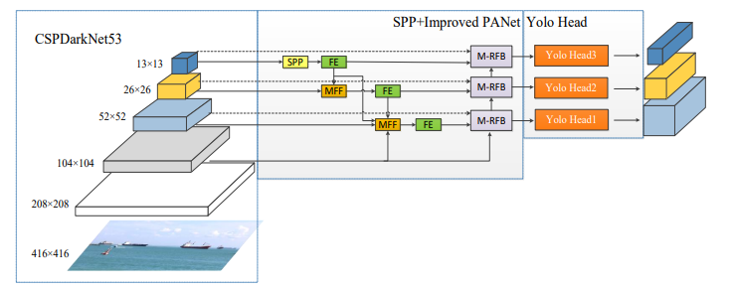
Related works
An Efficient Ship Detection and Classification Algorithm based on YOLOv4.
Fig: 3. The structure of Improved-YOLOv4
Proposed a YOLOv4 algorithm adopts the method of multi-scale feature fusion to improve the detection accuracy of small targets.
Integrating Multi-layer Feature Fusion (MFF) and Multi-layer Receptive Field Block (M-RFB) modules to enhance context information retention
¹ Weina Zhou, Lu Liu (2022)

Slide 6
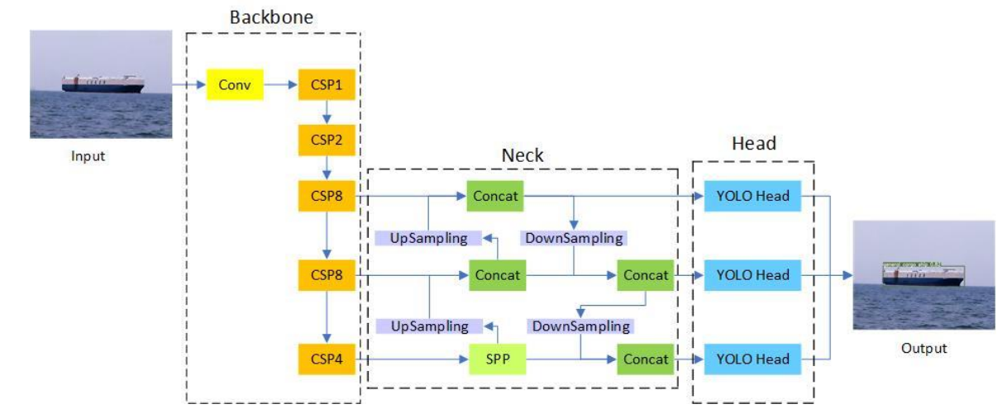
Related works
An Improved YOLO v4 Algorithm-based Object Detection Method for Maritime Vessels
Fig: 4. The network structure of YOLOv4
Enhances the YOLO v4 algorithm for ship object detection in maritime safety assistance,
introducing k-means clustering for improved input data organization and incorporating
berth data to address limitations in existing ship detection algorithms.
² Guowen He, Wenlong Wang

Slide 7
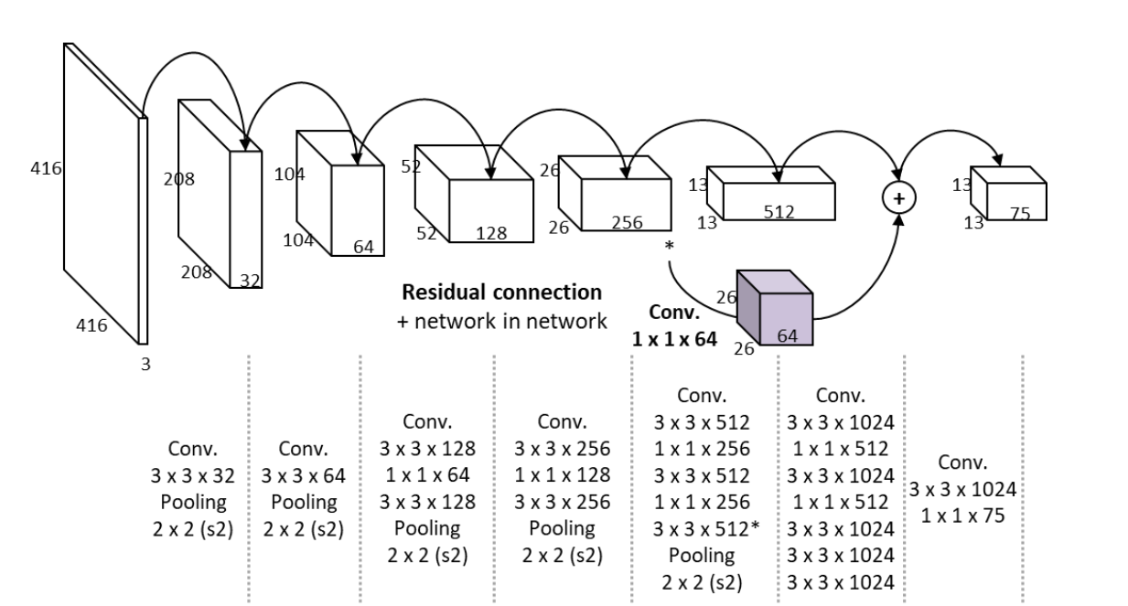
Related works
Image-based ship detection using deep learning
Fig.5: CNN with passthrough layer tailored for ship detection
Method tailored for ship detection in sea images and videos, utilizing a model trained
on a specialized maritime dataset to accurately classify ten specific classes.
Model shows a real-time detection speed of approximately 30 frames per second.
³ Sung-Jun Lee, Myung-Il Roh

Slide 8
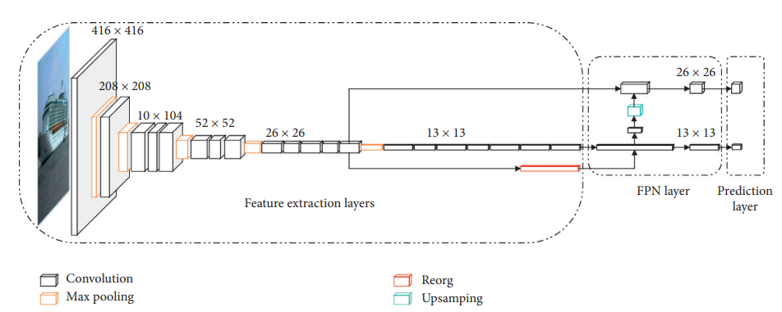
Related works
An Intelligent Ship Image/Video Detection and Classification Method with Improved Regressive Deep Convolutional Neural Network
Fig.6 : The network structure of the improved RDCNN by promoting YOLOv2 and v3.
Improved regressive deep convolutional neural network for ship image and video detection and classification, streamlining feature extraction, refining the feature pyramid network, customizing frames and scales for ships, and optimizing activation functions.
⁴ Zhijian Huang, Bowen Sui

Slide 9
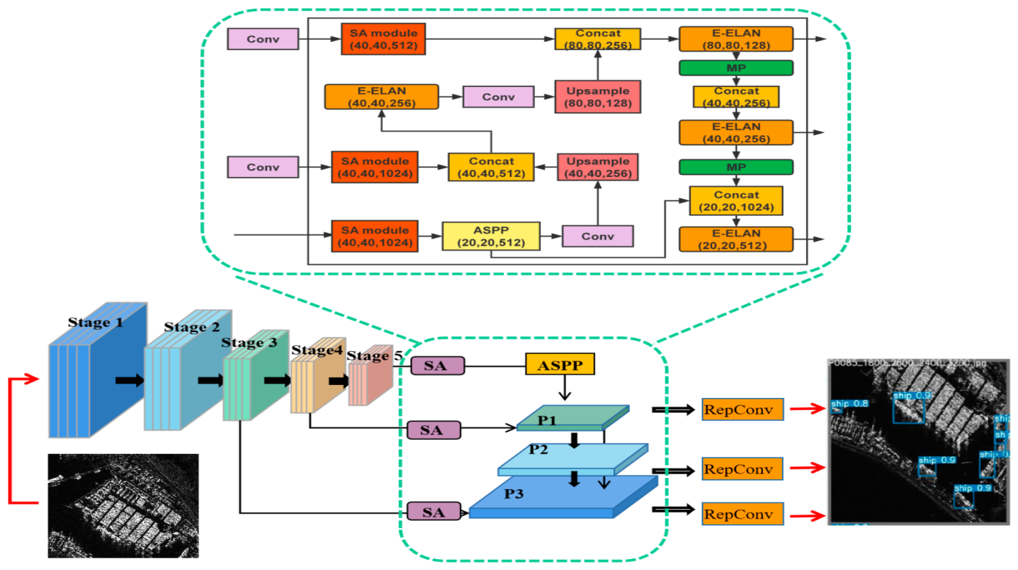
Related works
Multi-Scale Ship Detection Algorithm Based on YOLOv7 for Complex Scene
SAR Images
Fig.7 : The flow chart of the proposed method.
CSD-YOLO, a complex scenes multi-scale ship detection model based on YOLOv7, incorporating an SAS-FPN module and SIoU loss function to enhance detection accuracy in SAR images of complex scenes.
⁵ Zhuo Chen , Chang Liu

Slide 10
Related works
Sl No | Author | Title | Dataset | Year | Summary | Algorithm | Publication | Ship Detection
1 | Xuan Zhang, Mingzhong Yan | Marine ship detection and classification based on YOLOv5 model |  | 2022 | An enhanced YOLOv5-DN model, derived from YOLOv5, specifically designed for ship detection and classification in harbors and busy waterways by replacing the CSP-DarkNet module with CSP-DenseNet, achieving heightened precision in detecting and classifying six distinct maritime vessel types within port and waterway environments. | YOLO v5 | IOP Publishing: Journal of Physics: Conference Series | Visual image
2 | Kwanghyun Kim, Sungjun Hong | Probabilistic Ship Detection and Classification Using Deep Learning | ImageNet , PASCAL visual object classes (VOC), MS COCO | 2018 | Utilizing a three-stage process: employing Faster R-CNN for ship detection, integrating detections across frames to recover missed ships, and employing Bayesian fusion to determine ship classes, leveraging a dataset of thousands of ship images collected from Google image search for training and evaluation. | Deep learning | MDPI | Visual image
3 | Xu Han , Lining Zhao | ShipYOLO: An Enhanced Model for Ship Detection | Public ship dataset (SeaShips) | 2021 | Improves accuracy and speed through optimized CSPDarknet backbone, a novel DSPP module for small-scale ship detection, and an improved feature pyramid structure named AtFPN leveraging attention mechanisms and Resnet’s shortcuts. | YOLO v4 | Hindawi Journal of Advanced Transportation | Visual image
4 | Bo LI, Xiaoyang XIE | Ship detection and classification from optical remote sensing images: A survey | DOTA , Airbus Ship Detection | 2020 | The analyzing feature extraction strategies, algorithm performance, and available benchmark datasets for validation, while also highlighting remaining challenges and future directions in this field for both military and civilian applications. |  | Chinese Journal of Aeronautics | Optical remote sensing images
5 | Yicheng Gong , Zhuo Zhang | Small Ship Detection of SAR Images Based on Optimized Feature Pyramid and Sample Augmentation | PASCAL VOC | 2023 | The SSPNet introduces small-target-augmentation strategies in synthetic aperture radar (SAR) images, leveraging context attention, scale enhancement, and selection modules, alongside weighted negative sampling, to improve small ship detection, mitigating issues of false positives and missed detections in complex environments. | Deep learning | IEEE journal of selected topics in applied earth observations and remote sensing | Synthetic Aperture Radar

Slide 11
Related works
Sl No | Author | Title | Dataset | Year | Summary | Algorithm | Publication | Ship Detection
6 | Yuanrui Sun , Zhirui Wang | SPAN: Strong Scattering Point Aware Network for Ship Detection and Classification in Large-Scale SAR Imagery | LDSD | 2022 | The novel deep learning-based ship detection and classification network, SPAN, which leverages scattering characteristics in SAR images to accurately locate ships, compensate for feature loss, generate regions of interest, and classify ships, demonstrating superior performance in large-scale SAR datasets for ship detection and classification. | Deep learning | IEEE journal of selected topics in applied earth observations and remote sensing | Synthetic Aperture Radar
7 | Youran Zeng, Haiyan Yu and Jie Wang | Remote Sensing Ship Detection and Classification Based on Improved BBAVectors Algorithm | HRSC 2016 | 2023 | The BBAV-ACPP enhances the BBAVectors architecture by incorporating the Coordinate Attention Module and adjusting center point representation, resulting in improved detection accuracy without compromising the fast detection speed, making it suitable for real-time remote sensing ship detection and classification tasks. | Deep learning | Journal of Physics: Conference Series | Remote Sensing
8 | Zhelin Li, Lining Zhao, Xu Han | Lightweight Ship Detection Methods Based on YOLOv3 and DenseNet | Web crawler | 2020 | Lightweight ship detection model (LSDM) derived from YOLOv3, featuring a backbone network with dense connections inspired by DenseNet and spatial separation convolution in the feature pyramid networks. The LSDM demonstrates higher accuracy and speed for ship detection with only one-third of the parameters of YOLOv3 | YOLO v3 | Hindawi Mathematical Problems in Engineering | Visual image
9 | Jian Cen , Hao Feng | An Improved Ship Classification Method Based on YOLOv7 Model with Attention Mechanism | VOC2007 | 2023 | YOLOv7-RCBAM, enhancing YOLOv7 with a residual convolutional block attention module to improve feature extraction and object classification in ship detection. | YOLO v7 | Hindawi Wireless Communications and Mobile Computing | Visual image

Slide 12
Related works
Sl No | Author | Title | Dataset | Year | Summary | Algorithm | Publication | Ship Detection
10 | Dr. R Guru1, Shrinidhi T S | Real time ship detection using YOLOv5 | MS COCO | 2022 | Detecting and classifying ships in high-resolution optical remote sensing images is crucial for national maritime security and defense. To address accuracy, performance, and complexity challenges, this paper suggests employing YOLOv5 for real-time ship detection in such images. | YOLO v5 | International Research Journal of Engineering and Technology (IRJET) | Optical remote sensing images
11 | Liqiong Chen , Wenxuan Shi | Improved YOLOv3 Based on Attention Mechanism for Fast and Accurate Ship Detection in Optical Remote Sensing Images | PASCAL VOC | 2021 | Detecting ships in optical remote sensing images is tough due to their small size and environmental interference. An improved YOLOv3 with an attention mechanism, achieves real-time ship detection by efficiently balancing accuracy and speed, introducing a unique feature extraction module to address these challenges. | YOLO v3 | MDPI | Optical remote sensing images
12 | Dehai Chen , Shiru Sun | Ship Target Detection Algorithm Based on Improved YOLOv3 for Maritime Image | Public SeaShips | 2021 | A ship detection method in water using an improved YOLOv3 framework. It incorporates a feature attention module with an attention mechanism to enhance feature extraction in complex backgrounds and a feature enhancement module to improve semantic information fusion, achieving a superior detection accuracy. | YOLO v3 | Hindawi Journal of Advanced Transportation | Visual image
13 | Jiahuan Jiang, Xiongjun Fu | High-Speed Lightweight Ship Detection Algorithm Based on YOLO-V4 for Three-Channels RGB SAR Image | PASCAL VOC | 2021 | Ship detection in marine monitoring using a multi-channel fusion SAR image processing method, leveraging YOLO-V4-light to balance accuracy and real-time implementation. | YOLO v4 | MDPI | Synthetic Aperture Radar

Slide 13
Related works summary
Fig: 8. Number of Paper Publication (2018-2023)
Fig: 9. Common Dataset used in paper publication (2018-2023)

Slide 14
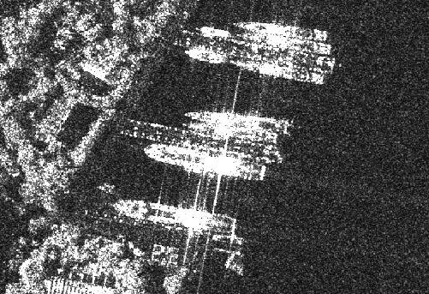
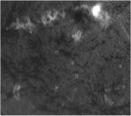
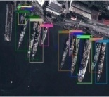
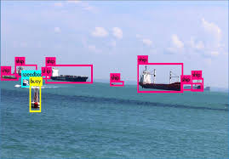
Related works summary
Ship detection
Synthetic Aperture Radar images
Space borne optical images
Visual image
Remote sensing image
Fig: 10. Ship detection images (2018-2023)
Fig: 11. Ship detection images based Paper Publication (2018-2023)

Slide 15
Research Gap
Significant study: While there exists an abundance of international research on ship detection and classification, a notable gap emerges due to the absence of studies conducted specifically within India.
Real-time Processing Challenges: Latency issues in object detection models hinder their practical implementation in time-critical applications, such as autonomous navigation.
Limited Ship Classification Models: Existing ship classification methods lack robustness across diverse environmental conditions encountered in maritime settings.
Limited Generalization in Ship Classification: Current ship classification models lack the ability to generalize effectively across different classes of vessels, leading to inaccuracies in distinguishing between similar ship types.

Slide 16
Objectives
Develop Robust Ship Classification: Create a ship classification model resilient to varying environmental conditions, ensuring high accuracy across diverse scenarios.
Enhance Real-time Performance: Overcome latency challenges in object detection models, enabling efficient and timely decision-making in ASV autonomy.
Achieve Fine-grained Classification: Develop a model capable of nuanced classification, accurately distinguishing between closely related ship categories, such as subtypes within cargo ships or variations in fishing vessels.
Enable Practical ASV Integration: Develop a framework that seamlessly integrates ship classification capabilities into ASVs, contributing to their autonomy and safety.

Slide 17
Problem Statement
To develop a Ship recognition based on YOLOv8 for Time Critical Applications in Autonomous Surface Vessel.

Slide 18
Proposed System
What’s New in YOLOv8
User-friendly API (Command Line + Python).
Faster and More Accurate.
Supports
Object Detection
Instance Segmentation
Image Classification.
Extensible to all previous versions.
New Backbone network.
New Anchor-Free head.
New Loss Function.

Slide 19
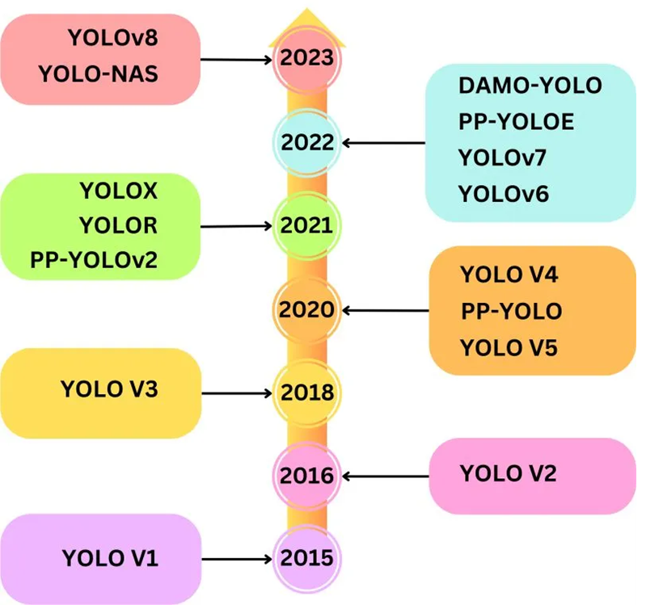
Yolo Object Detection Models Timeline
Fig: 12. Yolo Timeline
TheAiEdge.io

Slide 20
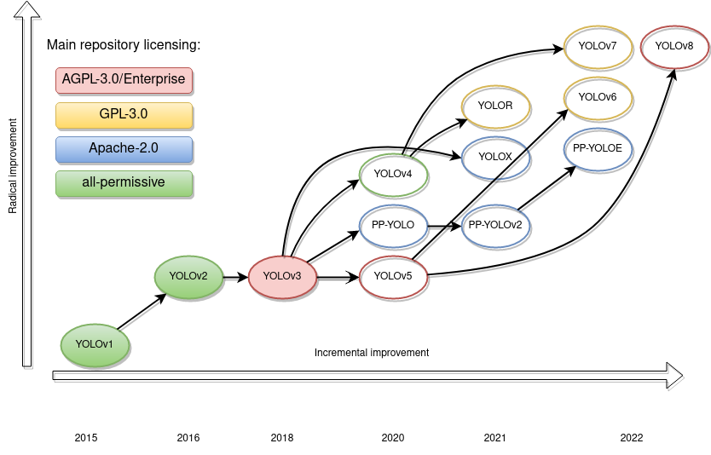
Advancements in Yolo V8 compared to previous versions
Fig: 13. Advancements in Yolo V8
medium.com

Slide 21
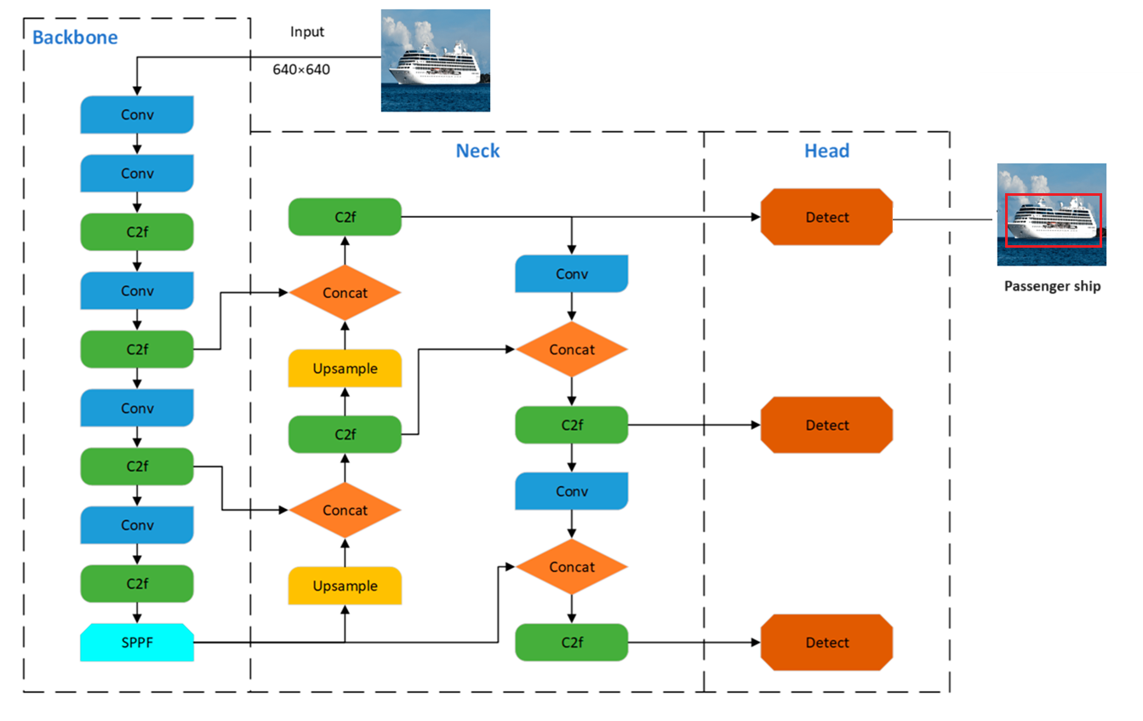
YOLO v8 network structure diagram
Fig: 14. Yolo v8 Network structure

Slide 22
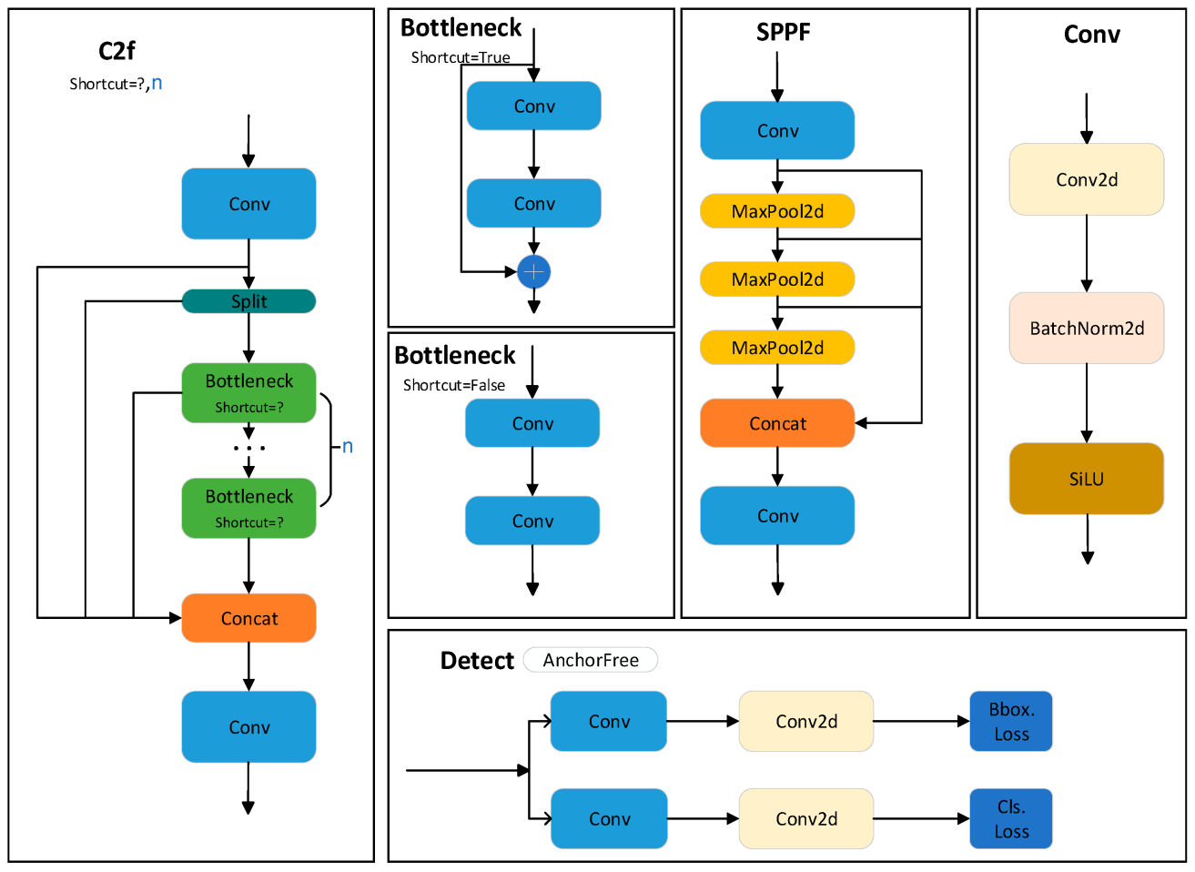
YOLO v8 network detail structure diagram.
Fig: 15. Yolo v8 Network detailed structure

Slide 23
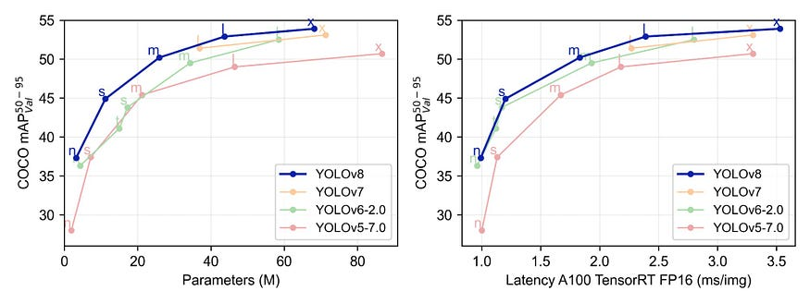
Dataset performance
Fig: 16. YOLOv8's Performance on COCO Dataset Surpasses Previous Versions
Source: GitHub

Slide 24
Tools
Google Colab: Cloud-based platform for writing and executing Python code, offering free access to CPUs and GPUs.
Python: High-level programming language known for its simplicity and readability.
Matplotlib: Comprehensive library for creating static, animated, and interactive visualizations in Python.
Ultralytics: Library for computer vision tasks including object detection, image classification, semantic segmentation, etc. Version 8.0.196 denotes a specific release version.
Roboflow: Platform simplifying the management and preprocessing of image datasets for machine learning projects.

Slide 25
Implementation
Utilized Google Colab notebook environment and Python programming language for deployment.
YOLOv8's advanced network structures and specialized modules employed for ship recognition.
Various layers within YOLOv8 architecture efficiently detect ships in images.
Neural network classifies objects in images and returns their names and probabilities.
Successful deployment and operation of YOLOv8 demonstrate its effectiveness in ship recognition.

Slide 26
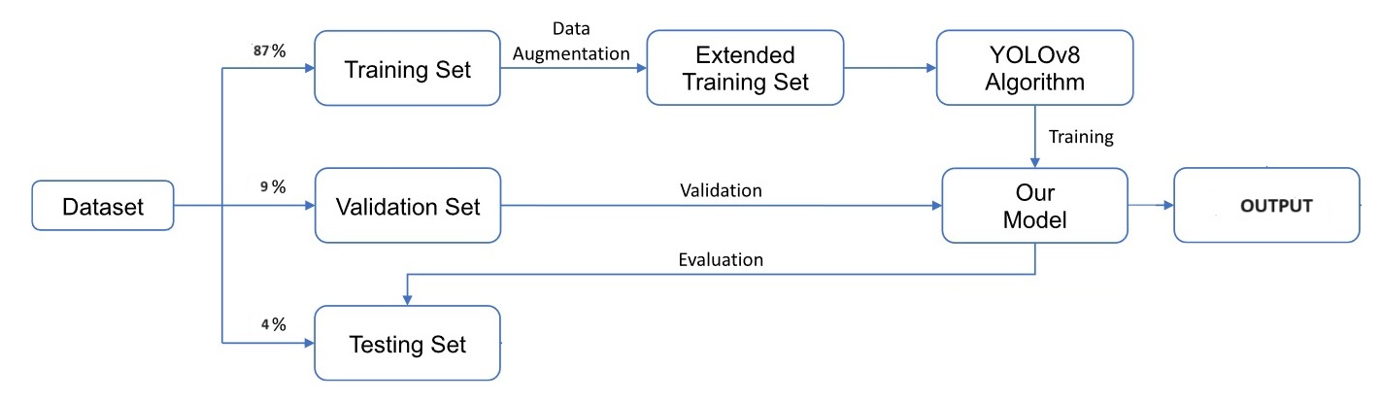
Proposed Workflow
Fig: 17. The dataset’s model training, validation, and testing flowchart. By utilizing data augmentation, the extended training set is employed to double the number of ship images.

Slide 27
Dataset Collection and Preparation
Collection: Showcasing ten types of ships collected from Kaggle websites, totaling 6596 images.
Preprocessing:
Auto-orientation and resizing of all images to 640x640 pixels.
Annotation:
Meticulous annotation providing spatial location and identity of ships in each image.
Augmentation:
Cropping with a range from 0% to 20% maximum zoom.
Adding blur of up to 2.5 pixels.
Dataset Partitioning:
Train Set: 87% of the data (13,713 images)
Valid Set: 9% of the data (1,355 images)
Test Set: 4% of the data (670 images)
Purpose:
Facilitates effective model training, validation, and evaluation.
Enhances confidence in model performance and generalization capabilities.

Slide 28
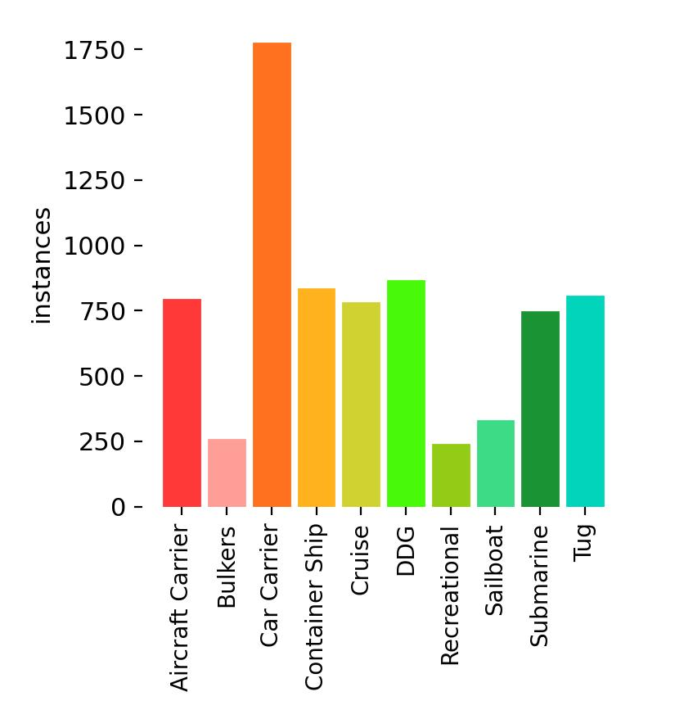
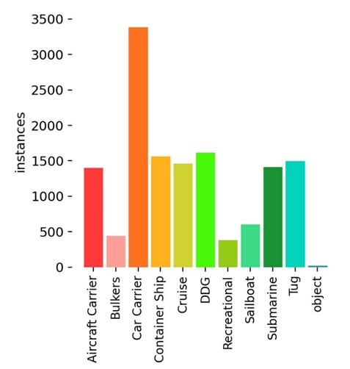
Dataset Collection and Preparation
Fig: 18. Different Class vs Instances

Slide 29
Experiment setup
Utilized a pre-trained YOLOv8 model on the MS COCO dataset as the foundation for our experiment.
Initially set the total number of epochs to 10 with a patience of 50, but later epochs increased into 30 for more efficient model training.
Leveraged GPUs with additional memory and processing capability to accelerate model training.
Conducted ablation research on the YOLOv8s model to demonstrate the positive effects of our training strategy on performance.
Fine-tuned the YOLOv8 model by optimizing numerous parameters to achieve the highest mean average precision value.
Overall, experiment showcases the effectiveness of our training strategy in enhancing the performance of the YOLOv8 model for ship recognition tasks.

Slide 30
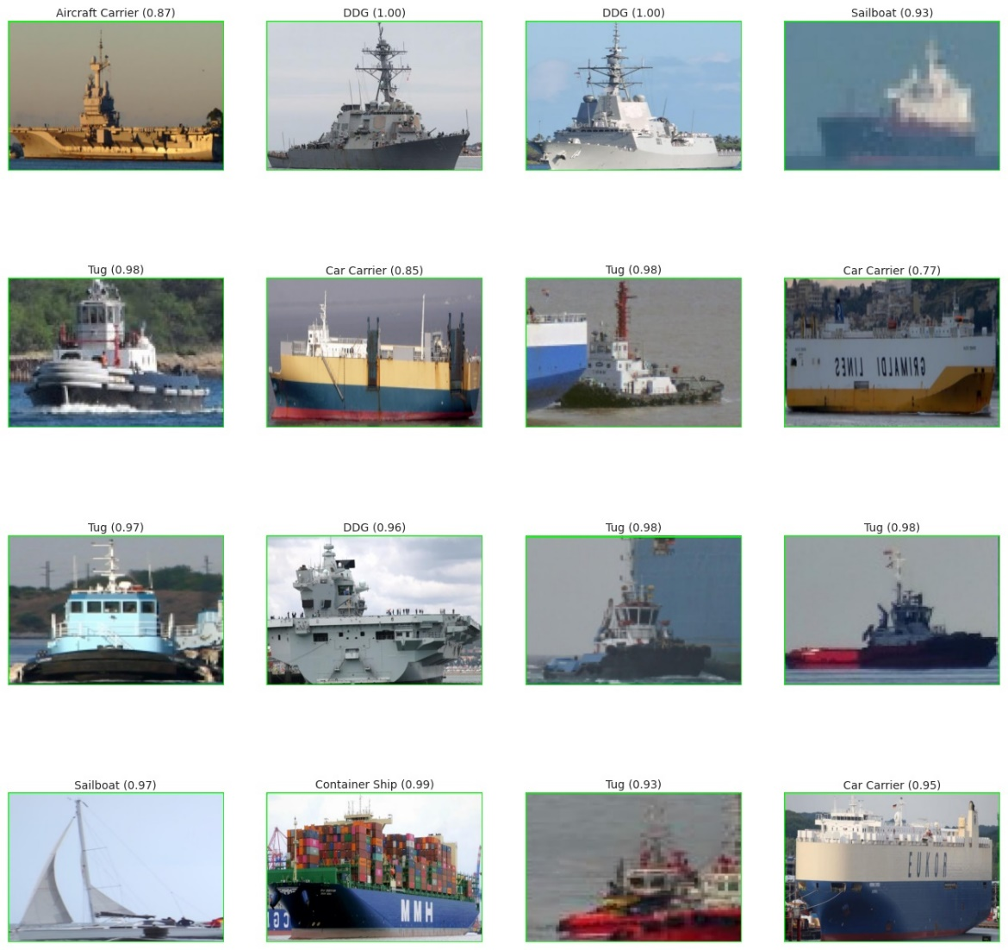
Results and Discussion
Fig: 19. Ship Detection Prediction

Slide 31
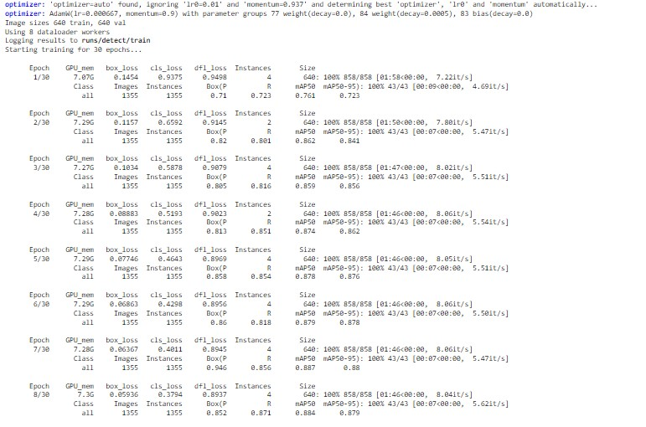
Results and Discussion
Fig: 20. Trained for 30 epochs

Slide 32
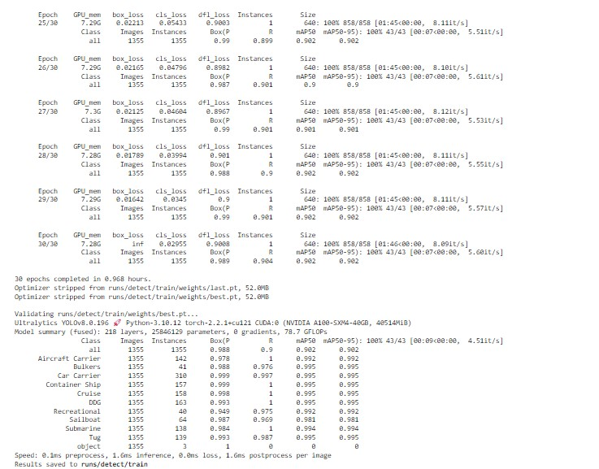
Results and Discussion
Fig: 22. Model summary

Slide 33
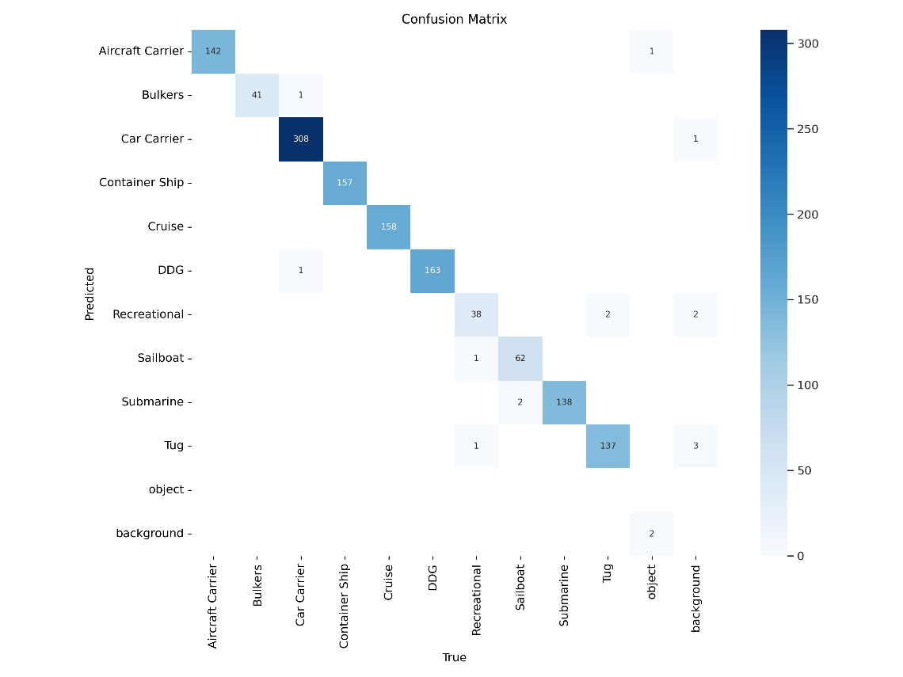
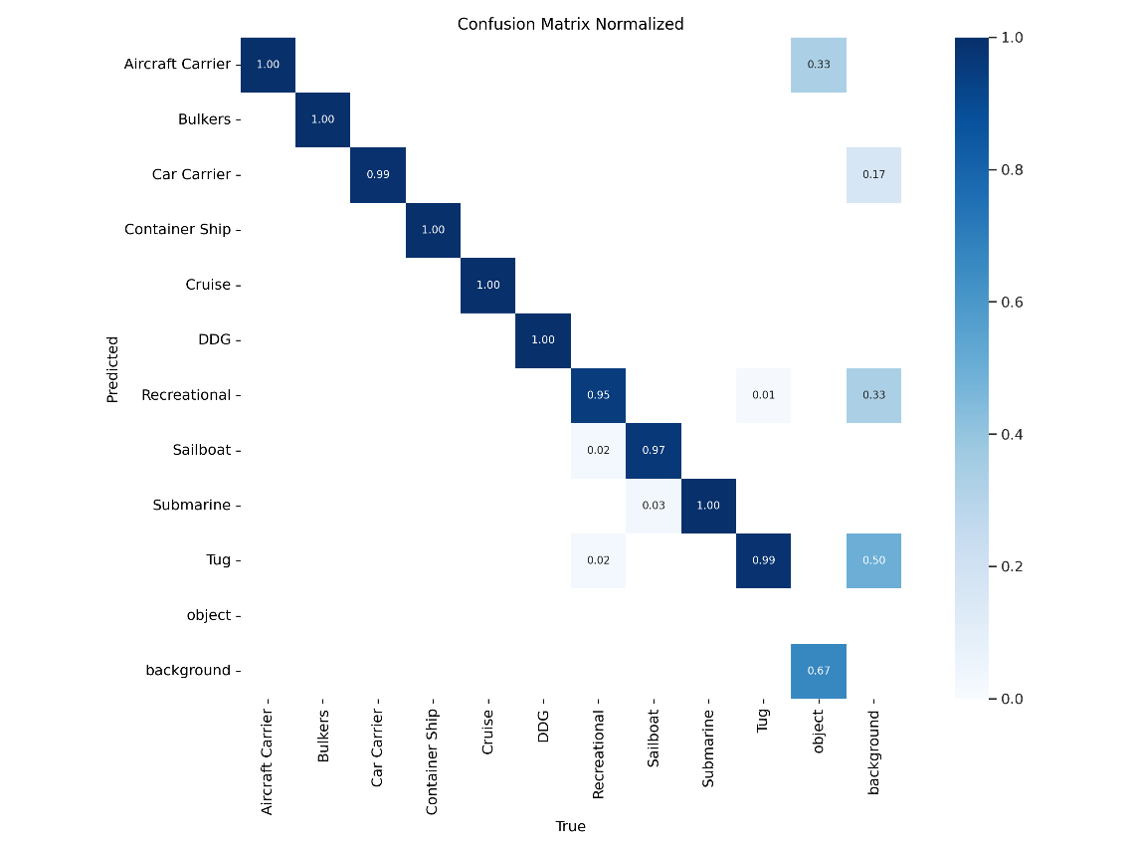
Results and Discussion
Fig: 21.Confusion Matrix

Slide 34
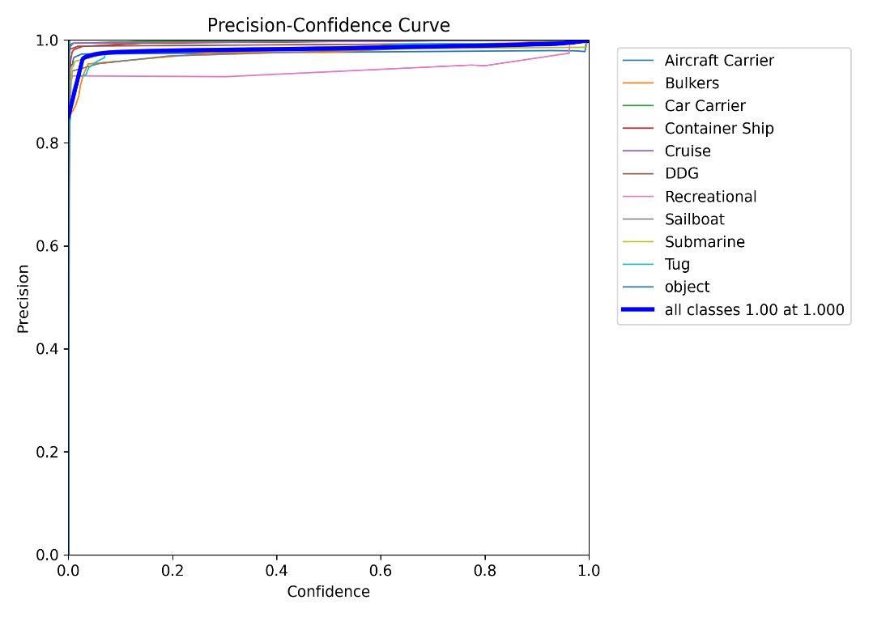
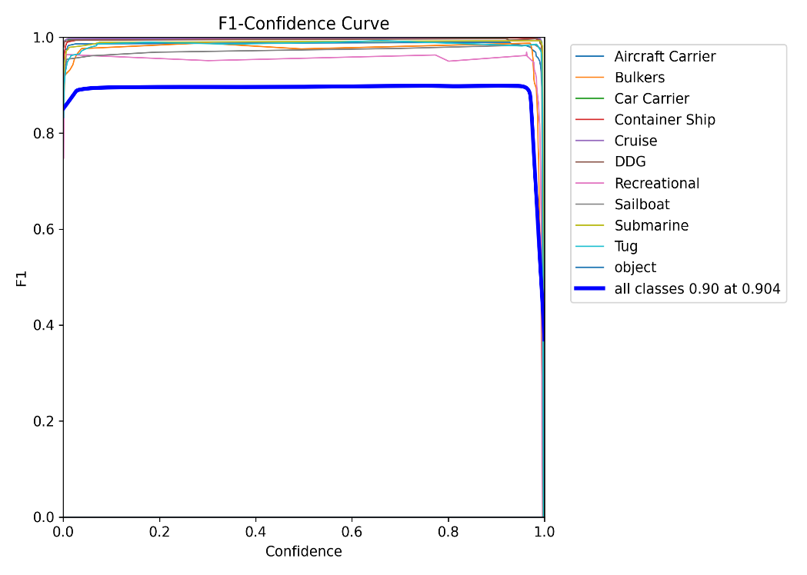
Results and Discussion
Fig: 23. Precision- Confidence Curve
Fig: 24. F1- Confidence Curve

Slide 35
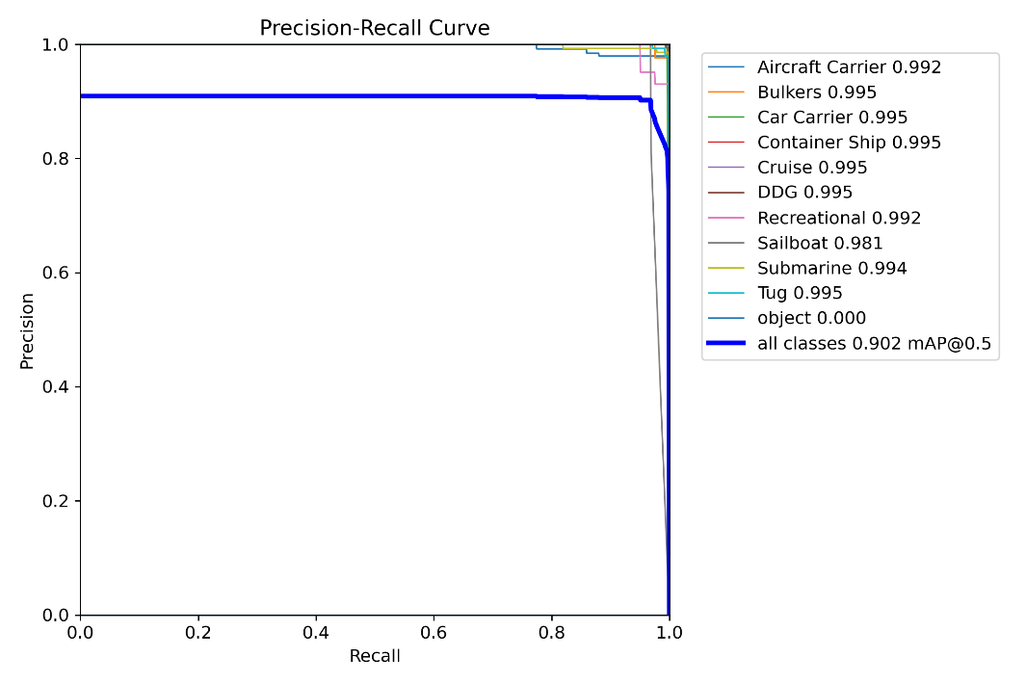
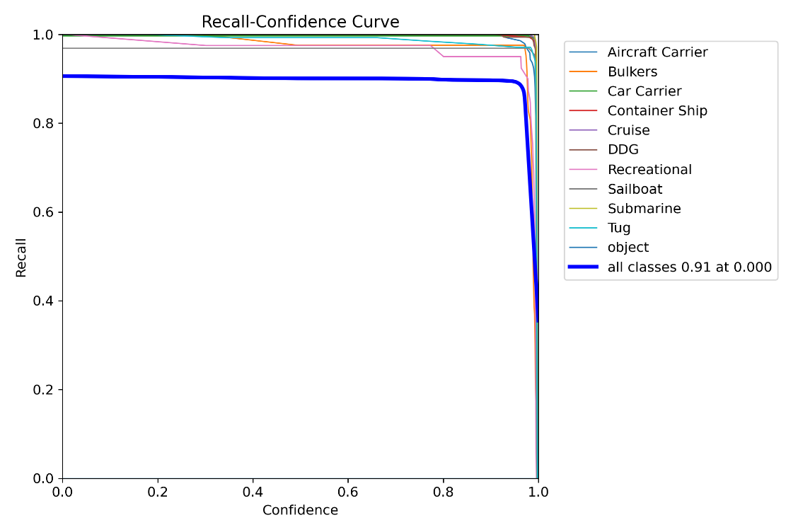
Results and Discussion
Fig: 25. Precision- Recall Curve
Fig: 26. Recall- Confidence Curve

Slide 36
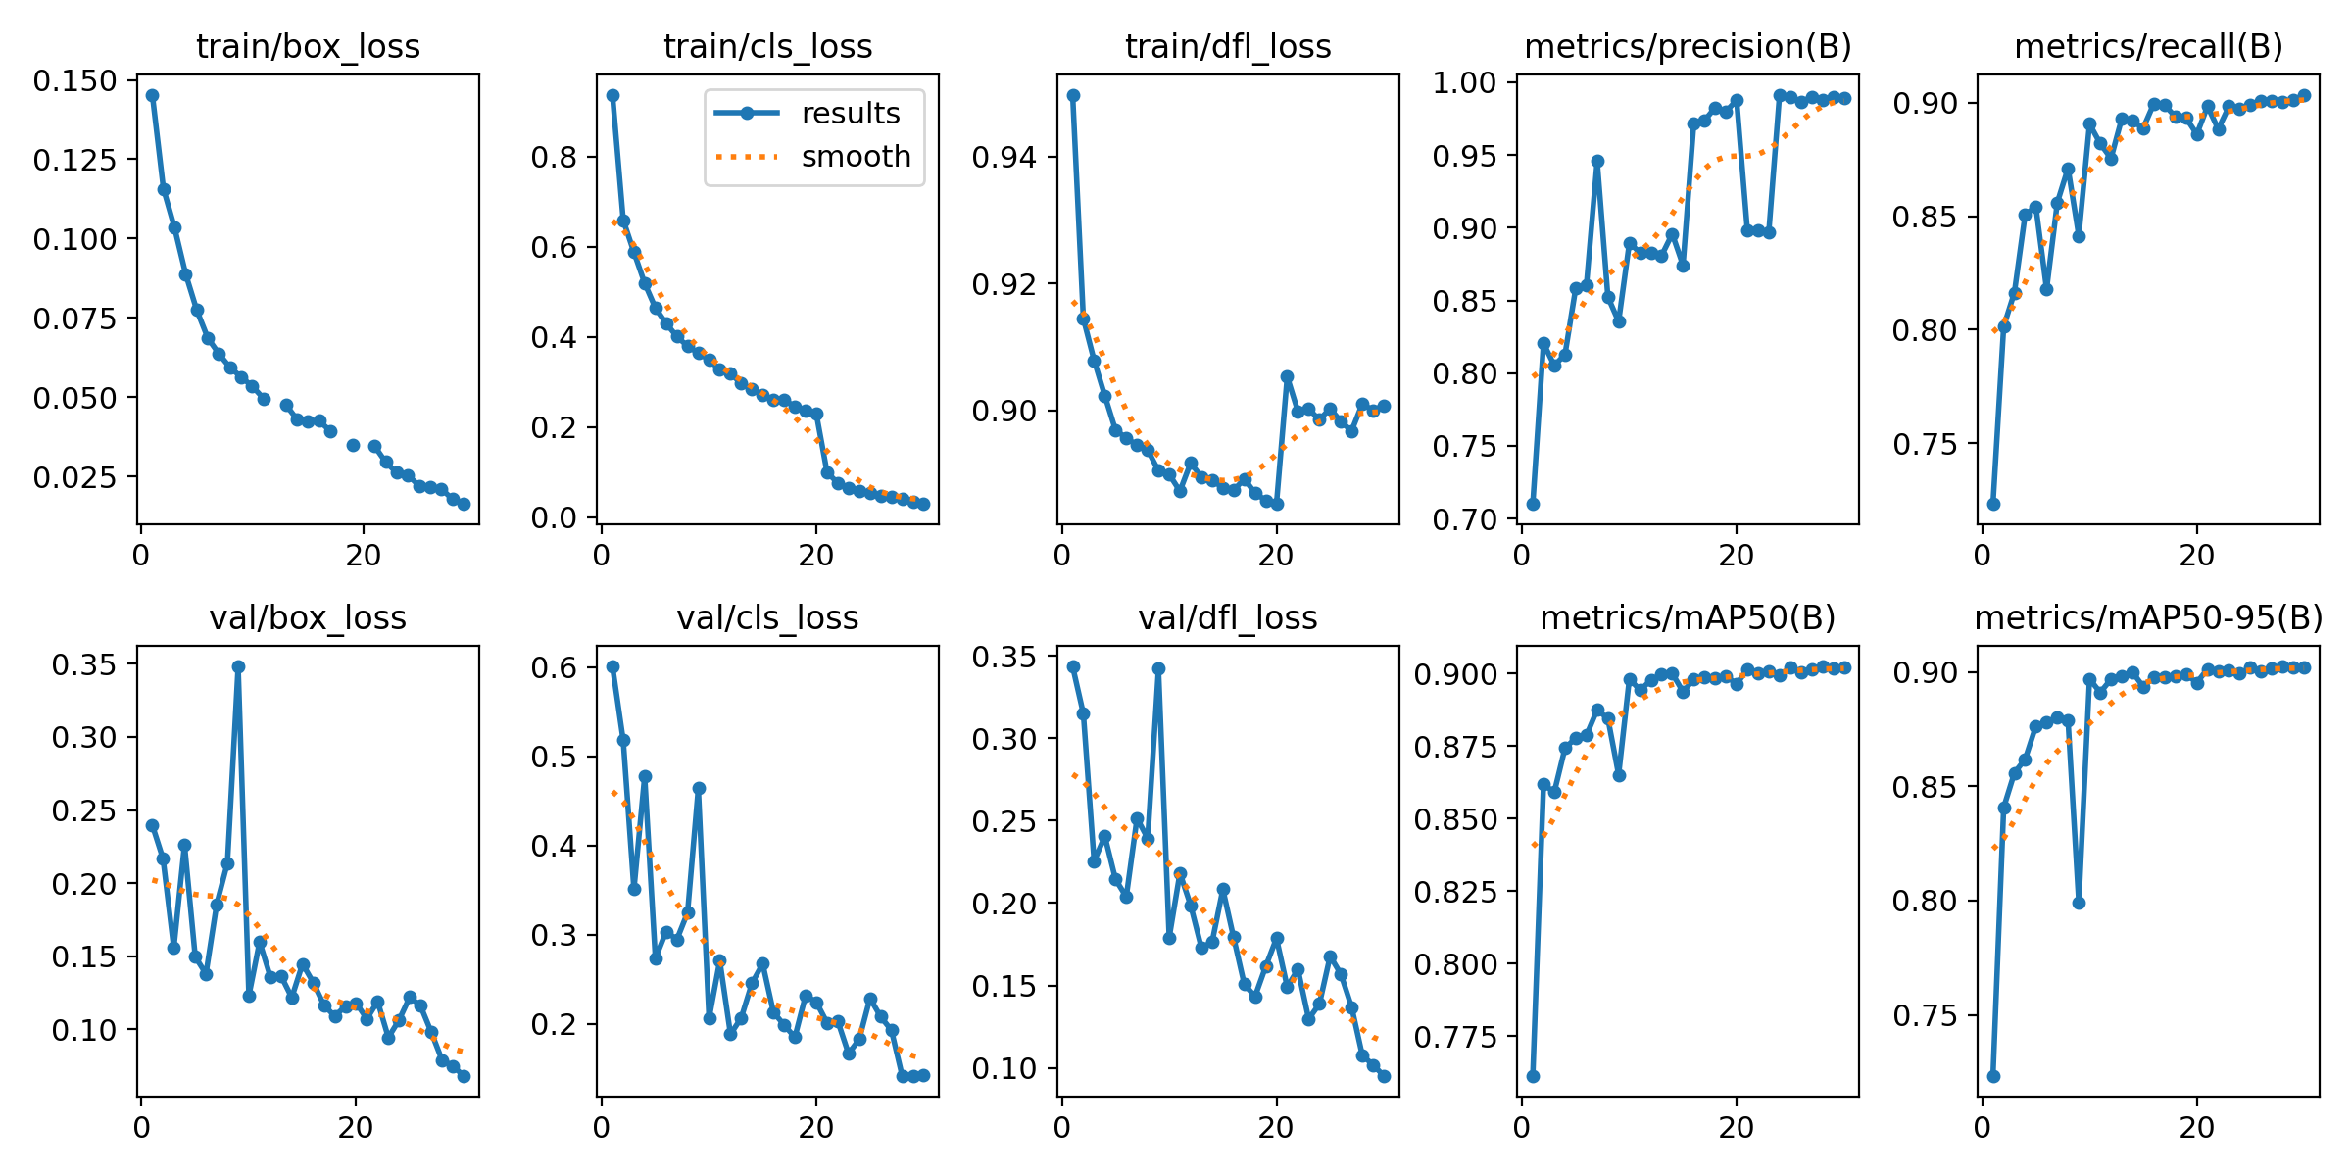
Results and Discussion
Fig: 27. Result

Slide 37

Model Prediction Result

Slide 38
Conclusion
The proposed algorithm based on YOLOv8 demonstrates exceptional performance in ship recognition tasks in complex marine environments.
Leveraging the capabilities of YOLOv8, the algorithm offers robust and real-time ship detection, enhancing maritime surveillance and safety operations.
A comprehensive preprocessing pipeline was implemented to prepare the dataset, ensuring uniformity and diversity across the training, validation, and test sets.
The YOLOv8 system for ship recognition is deployed and operational, effectively detecting ships in images with high accuracy.
Overall, the proposed algorithm holds great promise in revolutionizing ship recognition, contributing to safer and more efficient maritime activities.

Slide 39
References
[1] Weina Zhou, & Lu Liu. (n.d.). An Efficient Ship Detection and Classification Algorithm Based on YOLOv4, 8(4). https://doi.org/10.6919/ICJE.202204_8(4).0023
[2] He, G., Wang, W., Shi, B., Liu, S., Xiang, H., & Wang, X. (2022). An Improved YOLO v4 Algorithm-based Object Detection Method for Maritime Vessels. International Journal of Science and Engineering Applications, 11(04), 50–55. https://doi.org/10.7753/ijsea1104.1001
[3] Sung-Jun Lee , & Myung-Il Roh. (n.d.). Image-based ship detection using deep learning [Review of Image-based ship detection using deep learning ].
[4] Huang, Z., Sui, B., Wen, J., & Jiang, G. (2020). An Intelligent Ship Image/Video Detection and Classification Method with Improved Regressive Deep Convolutional Neural Network. Complexity, 2020, 1–11. https://doi.org/10.1155/2020/1520872
[5] Chen, Z., Liu, C., Vladimir Filaretov, & Dmitry Yukhimets. (2023). Multi-Scale Ship Detection Algorithm Based on YOLOv7 for Complex Scene SAR Images. Remote Sensing, 15(8), 2071–2071. https://doi.org/10.3390/rs15082071
[6] Zhang, X., Yan, M., Zhu, D., & Guan, Y. (2022). Marine ship detection and classification based on YOLOv5 model. Journal of Physics: Conference Series, 2181(1), 012025. https://doi.org/10.1088/1742-6596/2181/1/012025

Slide 40
References
[7] Kim, K., Hong, S., Choi, B., & Kim, E. (2018). Probabilistic Ship Detection and Classification Using Deep Learning. Applied Sciences, 8(6), 936. https://doi.org/10.3390/app8060936
[8] Han, X., Zhao, L., Ning, Y., & Hu, J. (2021). Ship YOLO: An Enhanced Model for Ship Detection. Journal of Advanced Transportation, 2021, 1–11. https://doi.org/10.1155/2021/1060182
[9] LI, B., XIE, X., WEI, X., & TANG, W. (2021). Ship detection and classification from optical remote sensing images: A survey. Chinese Journal of Aeronautics, 34(3), 145–163. https://doi.org/10.1016/j.cja.2020.09.022
[10] LI, B., XIE, X., WEI, X., & TANG, W. (2021). Ship detection and classification from optical remote sensing images: A survey. Chinese Journal of Aeronautics, 34(3), 145–163. https://doi.org/10.1016/j.cja.2020.09.022
[11] Gong, Y., Zhang, Z., Wen, J., Lan, G., & Xiao, S. (2023). Small Ship Detection of SAR Images Based on Optimized Feature Pyramid and Sample Augmentation. IEEE Journal of Selected Topics in Applied Earth Observations and Remote Sensing, 1–8. https://doi.org/10.1109/jstars.2023.3302575

Slide 41
References
[12] Sun, Y., Wang, Z., Sun, X., & Fu, K. (2022). SPAN: Strong Scattering Point Aware Network for Ship Detection and Classification in Large-Scale SAR Imagery. IEEE Journal of Selected Topics in Applied Earth Observations and Remote Sensing, 15, 1188–1204. https://doi.org/10.1109/jstars.2022.3142025
[13] Zeng, Y., Yu, H., & Wang, J. (2023). Remote Sensing Ship Detection and Classification Based on Improved BBA Vectors Algorithm. Journal of Physics: Conference Series, 2522(1), 012012–012012. https://doi.org/10.1088/1742-6596/2522/1/012012
[14] Cen, J., Feng, H., Liu, X., Hu, Y., Li, H., Li, H., & Huang, W. (2023). An Improved Ship Classification Method Based on YOLOv7 Model with Attention Mechanism. Wireless Communications and Mobile Computing, 2023, 1–18. https://doi.org/10.1155/2023/7196323
[15] Dr. R Guru, & Shrinidhi T S. (n.d.). Real time ship detection using YOLOv5 [Review of Real time ship detection using YOLOv5]. International Research Journal of Engineering and Technology (IRJET).

Slide 42
Thankyou for your kind attention !

